Slide 1
Bird Strike Report
SAFIKA PARWEEN

Slide 2
Index No. | Title | Page No
1 | Introduction | 3
2 | Objective | 4
3 | Data Sharing Agreement | 5
4 | Insights | 6
5 | KPIs | 7
6 | My design | 8

Slide 3
INTRODUCTION
Through a thorough analysis of bird strike reports, this study aims to contribute valuable insights to the aviation industry, enhancing our understanding of the factors contributing to bird strikes and informing strategies to minimize their impact on flight safety.
By identifying patterns and areas for improvement, this analysis seeks to support the ongoing efforts to create a safer and more secure aviation environment.

Slide 4
OBJECTIVE
The objective of the project is to conduct a thorough analysis of bird strike incidents to enhance aviation safety. By examining historical data and patterns of bird strikes, the project aims to identify high-risk areas, species involved, and contributing factors. This analysis will provide valuable insights for the development of effective preventive measures and mitigation strategies, ultimately minimizing the impact of bird strikes on aircraft and improving overall aviation safety. The project seeks to offer a data-driven understanding of bird strike occurrences through visual representation and facilitate the implementation of targeted solutions to reduce the risks associated with bird strikes in aviation.
using Microsoft Power Bi

Slide 5
DATA SHARING AGGREMENT
File Name: Bird strike data.csv
Dataset Size : 3.74MB
Number of Rows: 25559
Number of columns: 26

Slide 6
INSIGHTS
KPIS
Cost analysis
Damage & altitude analysis

Slide 7
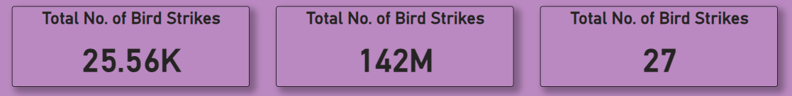
KPIS

Slide 8
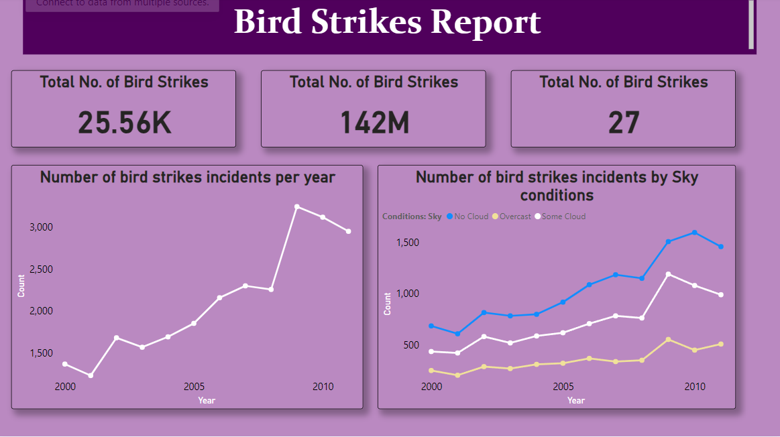
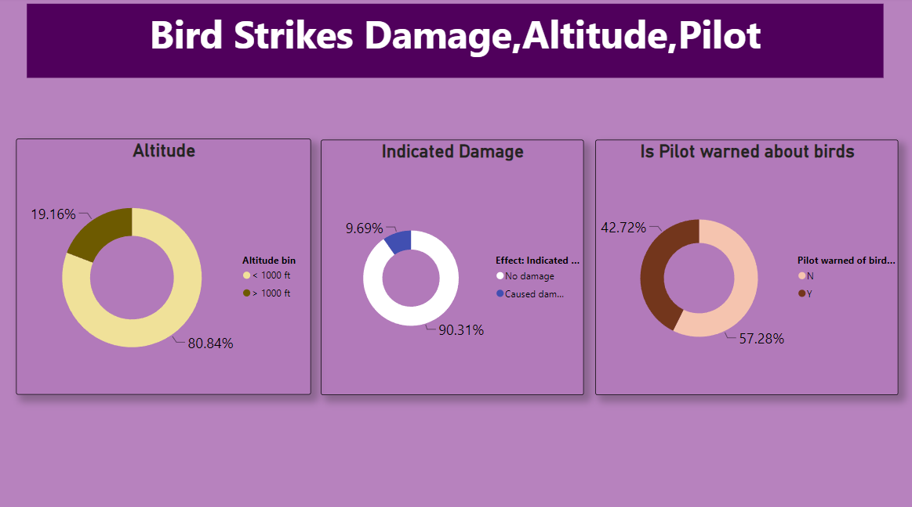
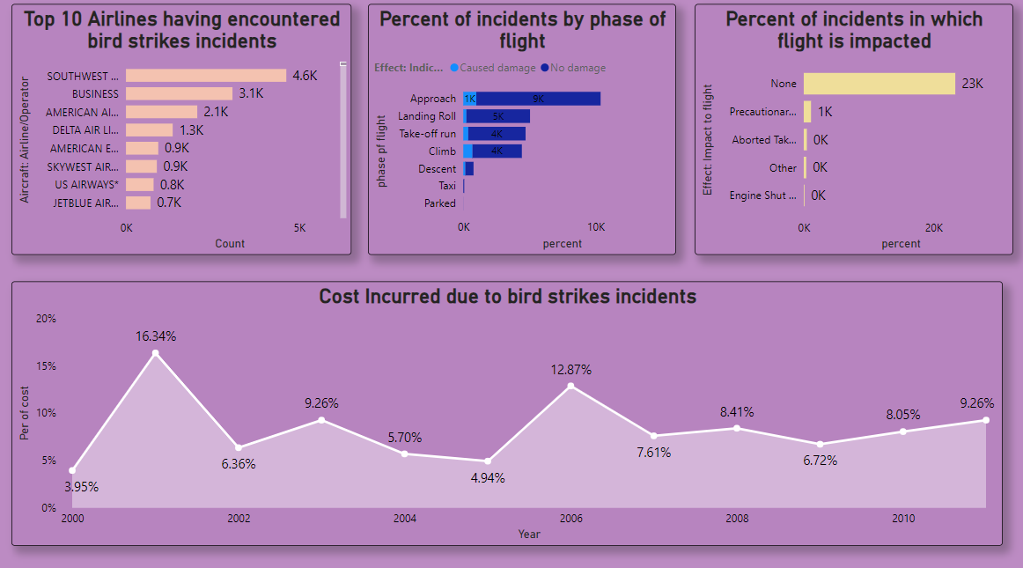
MY DESIGN

Slide 9
THANK YOU

